Slide 1
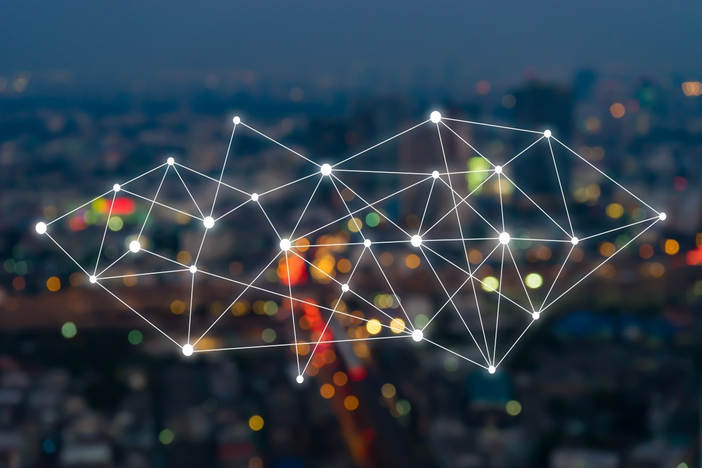
What do you think IOT is ?

Slide 2

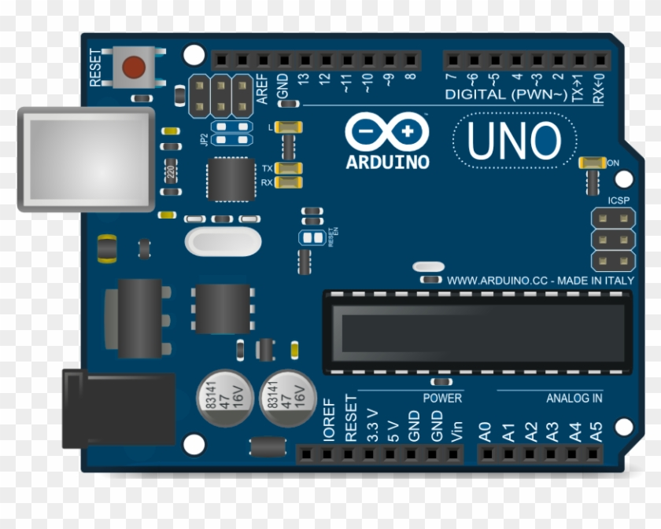
A microcontroller is an integrated circuit (IC) that can be programmed to perform a set of functions to control a collection of electronic devices.
A self-contained system in which a processor, support, memory, and input/output (I/O) are all contained in a single package.
Being programmable is what makes the microcontroller unique.
Micro-controller

Slide 3


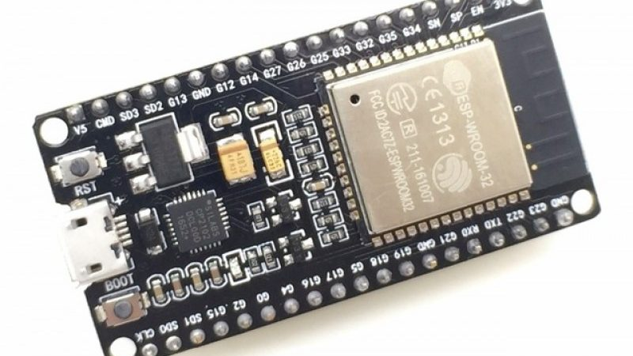
What is ESP32 !

Slide 4
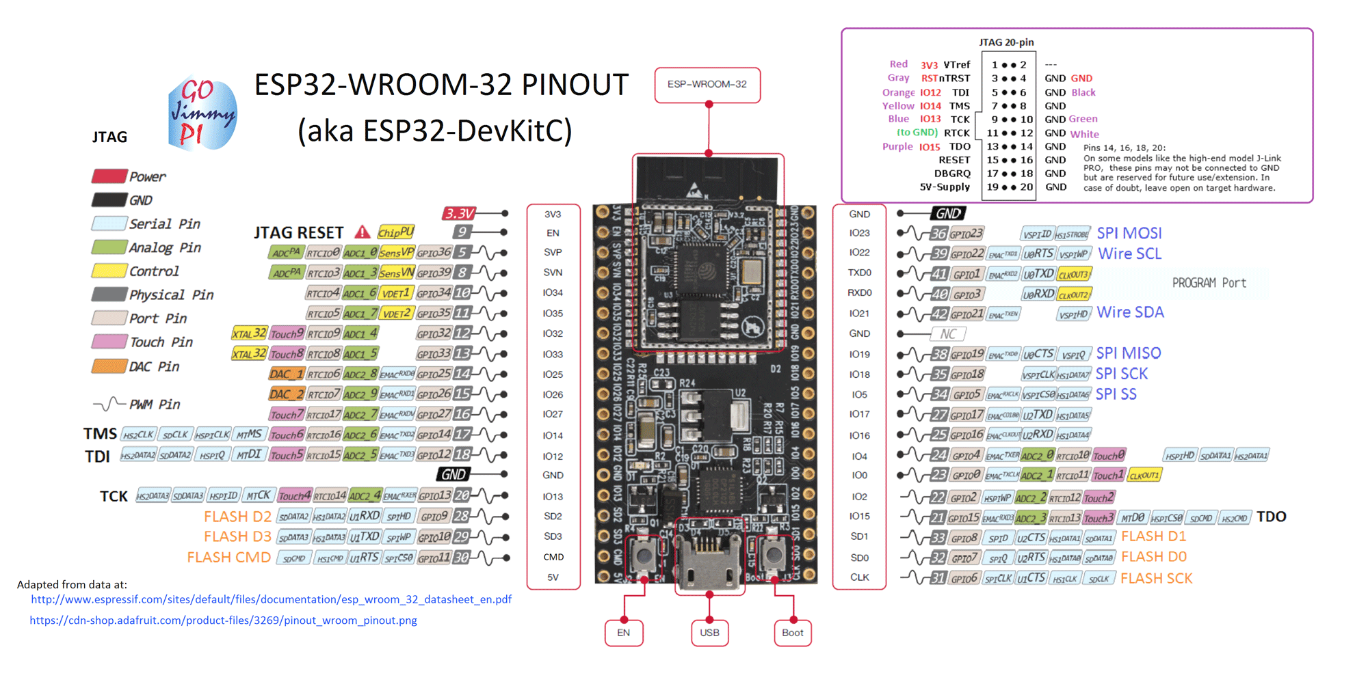

Slide 5
ALWAYS REMEMBER THERE IS NO BETTER TEACHER than GOOGLE !

Slide 6
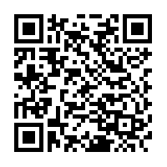
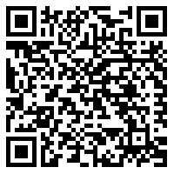
Setting up Arduino for esp32
https://dl.espressif.com/dl/package_esp32_dev_index.json
Tools Board Board Manager
https://www.silabs.com/products/development-tools
/software/usb-to-uart-bridge-vcp-drivers
Search ESP32

Slide 7
How to run and upload programme
Hard reset!
Important note !
GPIO is not 5V tolerant on board

Slide 8
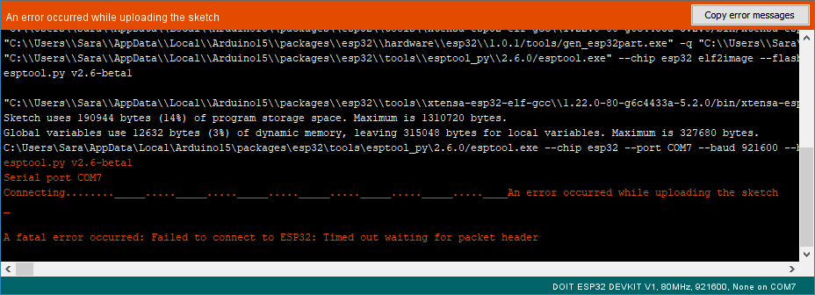

Slide 9
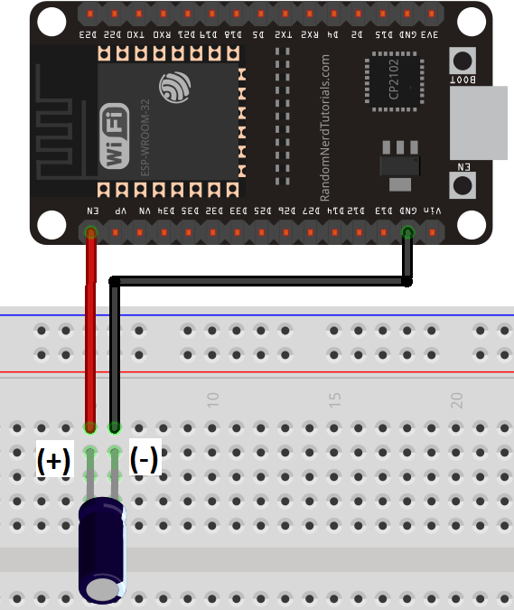
How to escape from this
To make your ESP32 board go into flashing/uploading mode automatically, you can connect a 10 muF electrolytic capacitor between the EN pin and GND.

Slide 10

Blynk is a Platform with IOS and Android apps to control Arduino, Raspberry Pi and the likes over the Internet.
Its as simple as dragging and dropping widgets

Slide 11
How to create Blynk account that connects to our local server...
1. Connect your phone to NTUSECURE Wifi network.
2. Open Blynk app. At home screen, click "Create New Account".
3. Click the logo at bottom of screen to access Server Settings.
4. Set IP address to the IP address of the server. (172.28.220.239)
5. Set port to 9443. Click "OK".
6. Enter your preferred email address and password. REMEMBER THESE!
7. Create account and you are go! You can create new project(s) by clicking "New Project" after you sign up/login . Keep your phone connected to NTUSECURE!

Slide 12
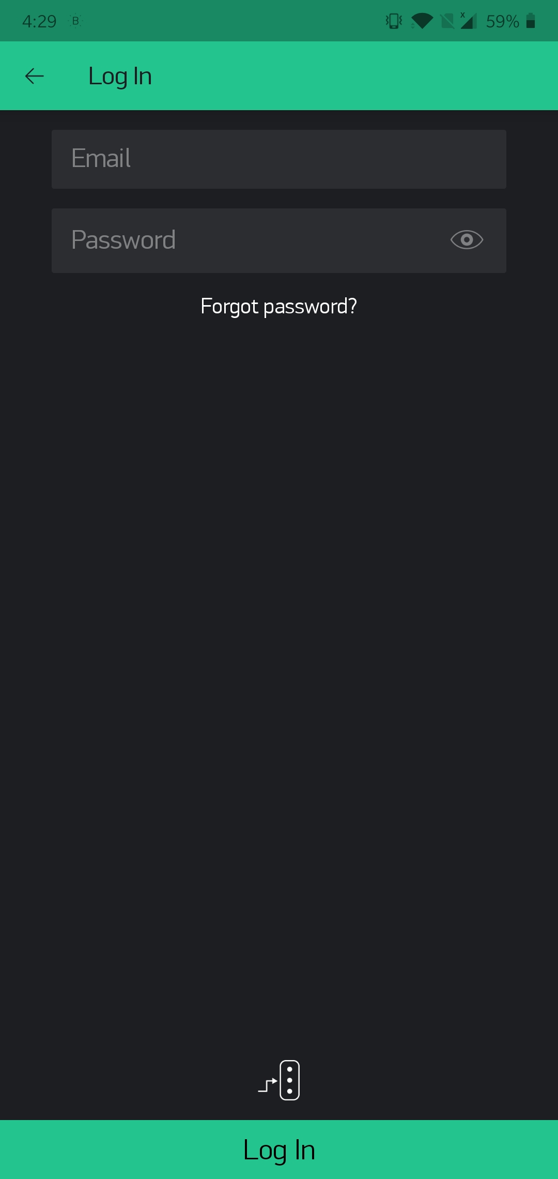
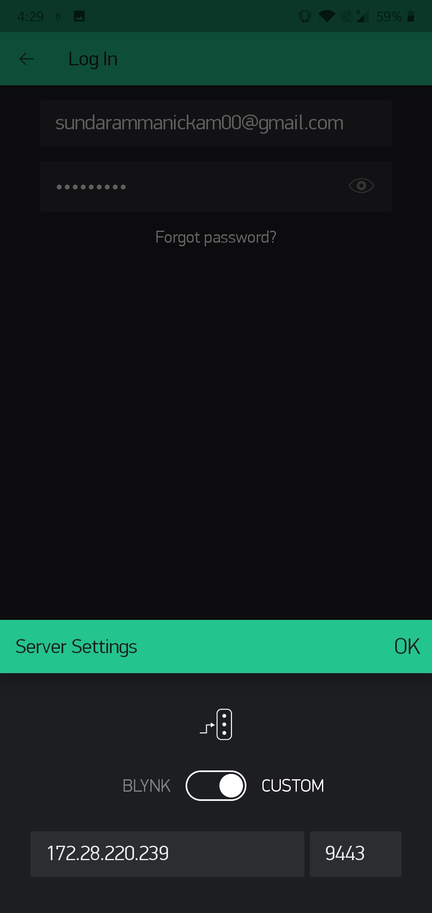

Slide 13
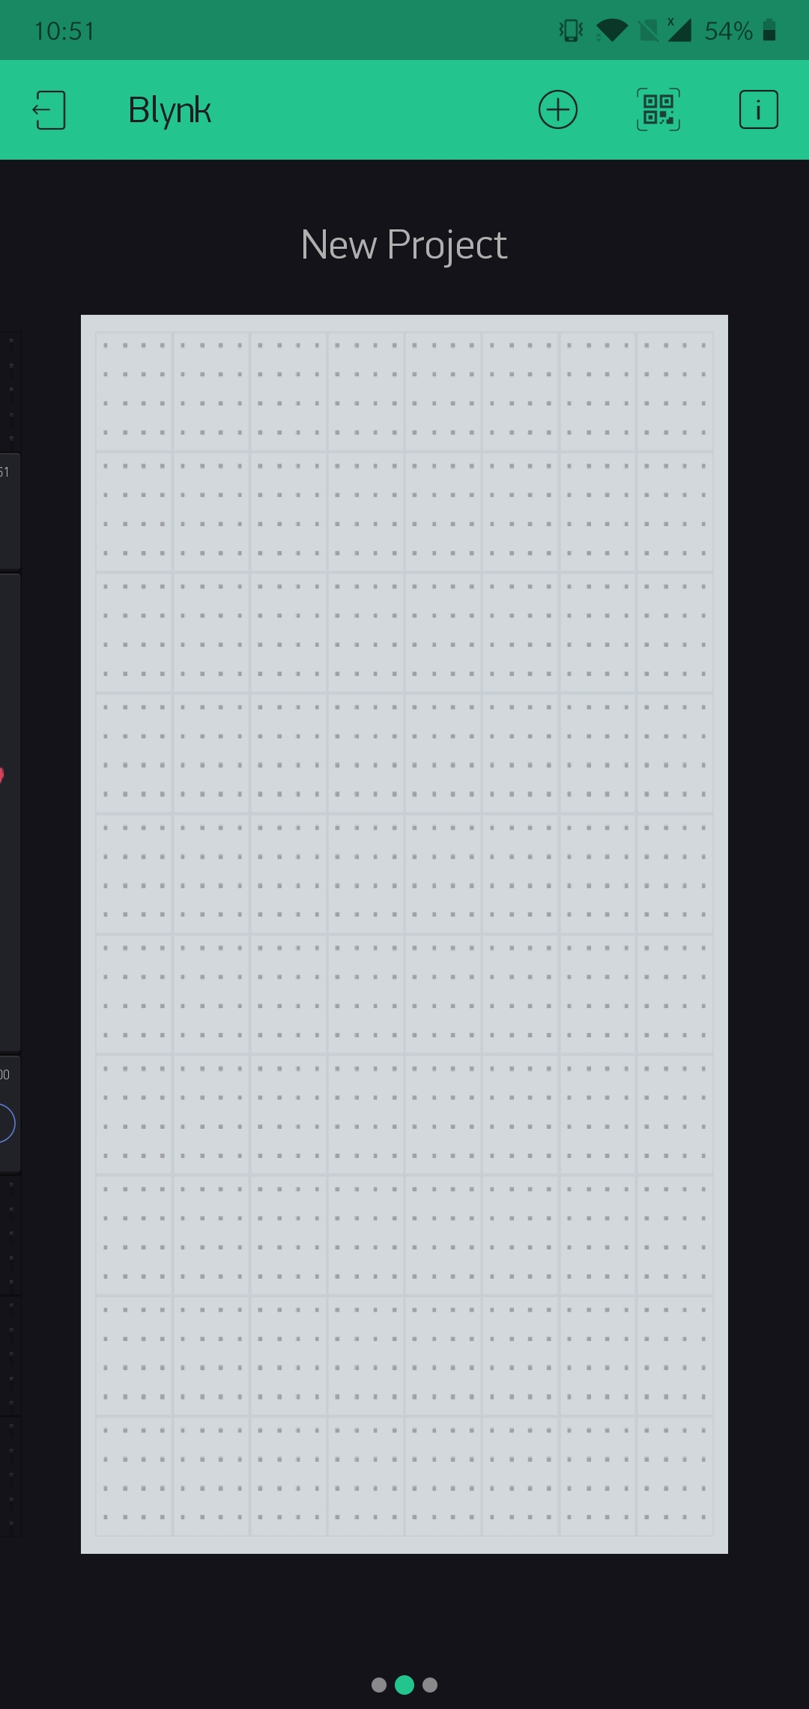
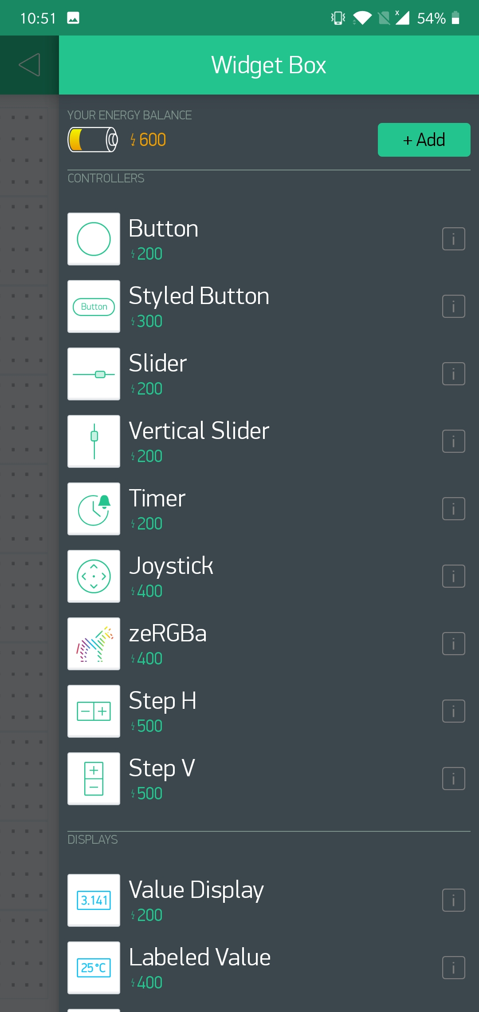
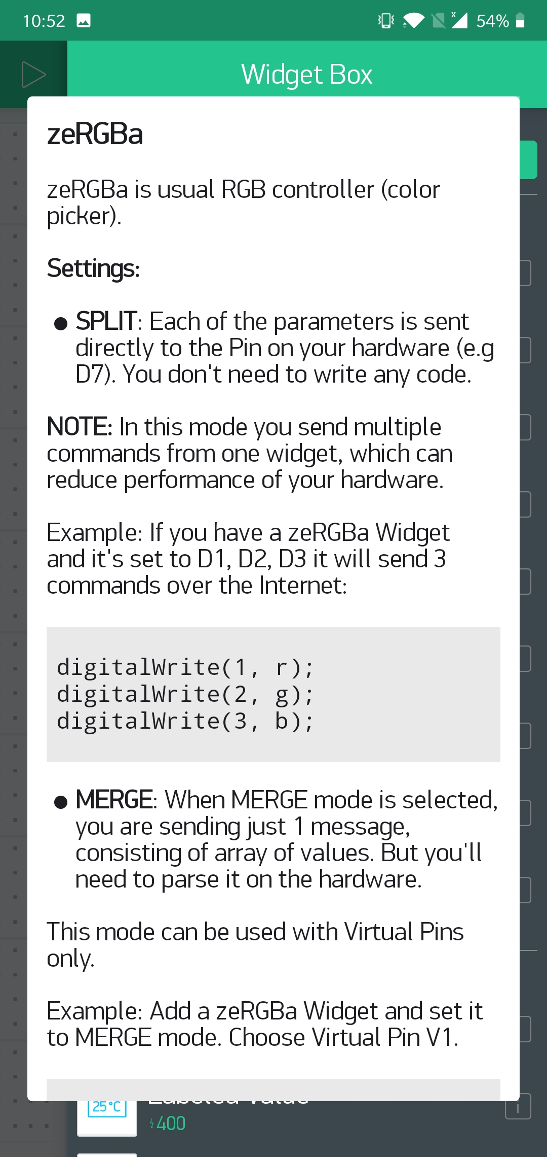
As you can see here the no. of widgets that u can add is restricted

Slide 14
For connecting to ENTERPRISE NETWORK...
P.S. Both your phone and your ESP32 should be connected to NTUSECURE

Slide 15
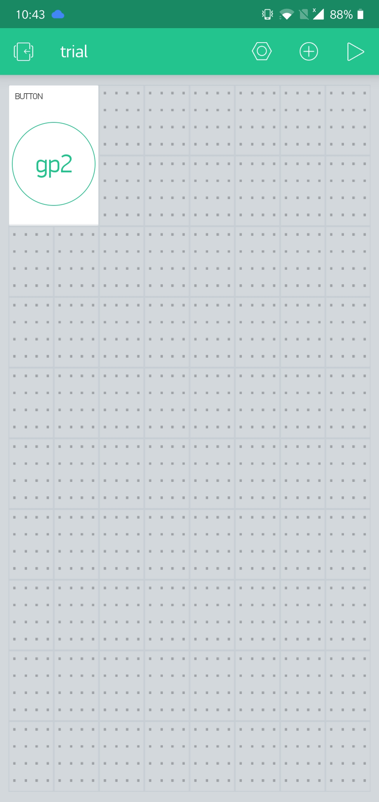
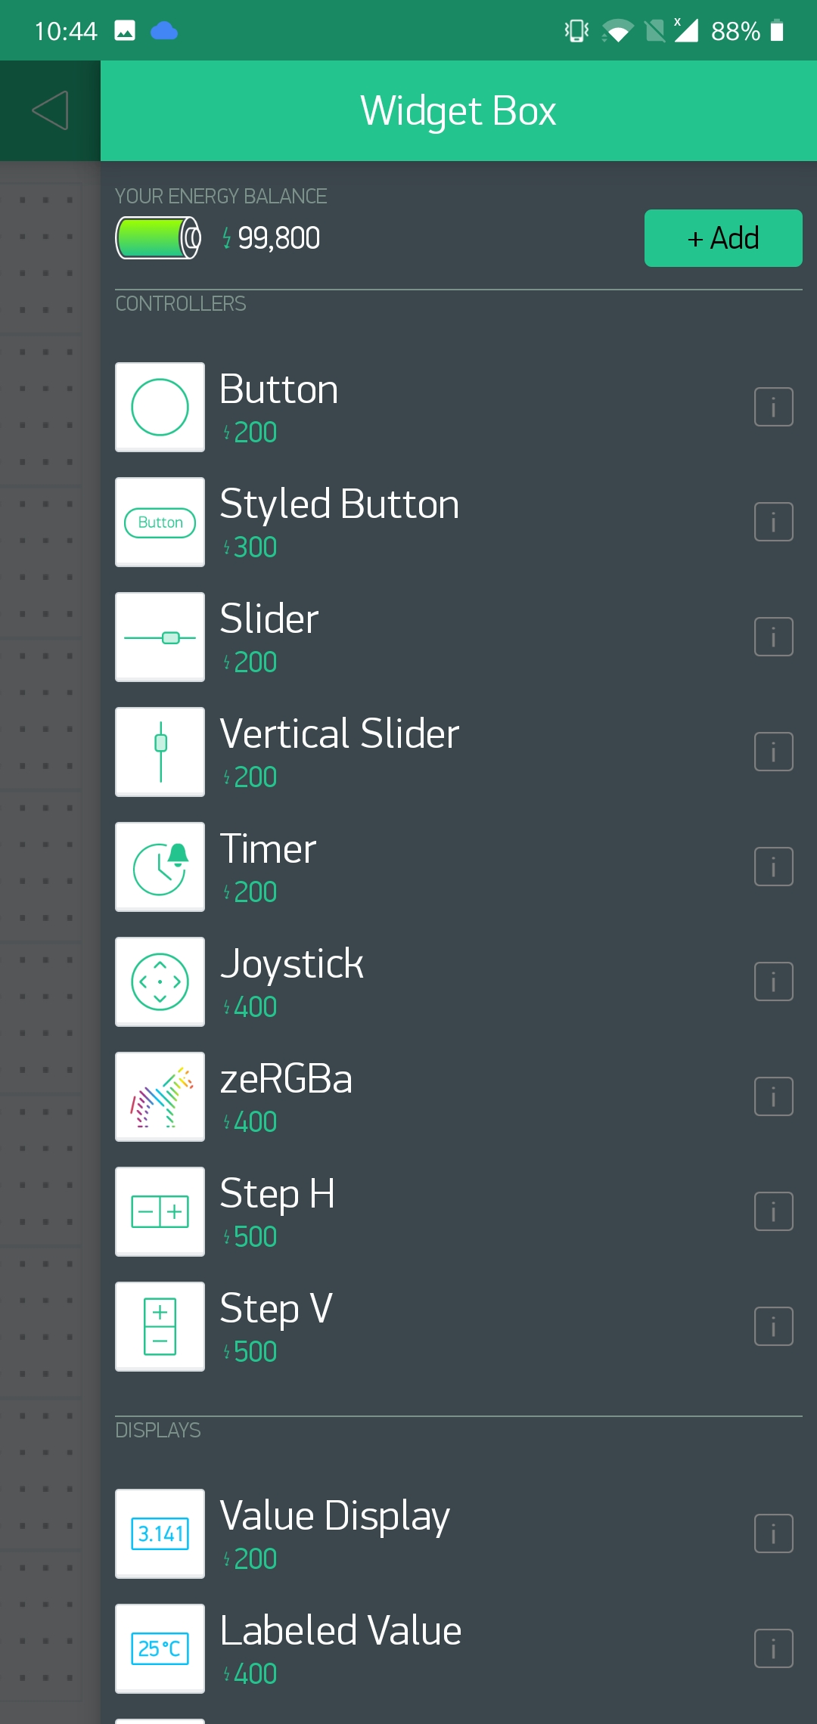
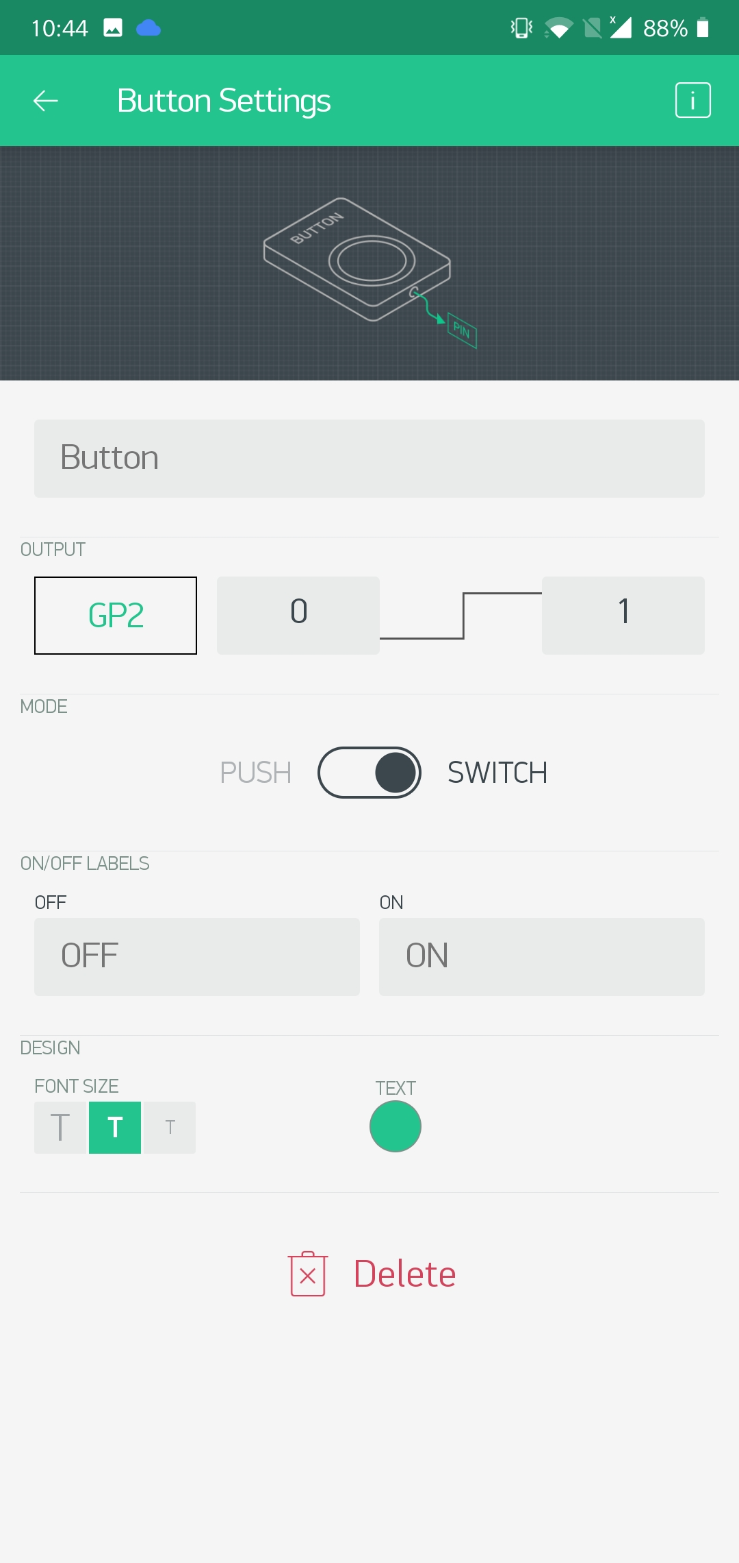
On-board LED Blinking using BLYNK
Click the button widget Select GP2 GP2 is the inbuilt LED port

Slide 16
Virtual pins
Virtual Pin is a concept that helps in exchange of any data between hardware and Blynk mobile app.
Virtual pins are different than Digital and Analog Input / Output (I/O) pins

Slide 17
LED strip brightness control using virtual pins
We will be using FastLED HERE
Go to sketch include library manage library
search FastLED

Slide 18
PUSh notification
Now we will be seeing how to send information from board to phone

Slide 19
Thank You!

